Slide 1









RADSeq Data Analysis
Through STACKS on Galaxy
Yvan Le Bras
Anthony Bretaudeau
Cyril Monjeaud
Gildas Le Corguillé

Slide 2
INTRODUCTION
RAD sequencing: next-generation tools for an old problem
source: Karim Gharbi - edinburgh genomics / University of Edinburgh

Slide 3
The NGS revolution in the GBS world
Alloenzymes, RAPD, AFLP, Microsatellites, SNP array, […], NGS
NGS: Low cost sequencing …
But it’s still expensive to get enough markers on enough samples
Solution: sampling the genome
BEWARE: the analysis is not cheap!

Slide 4
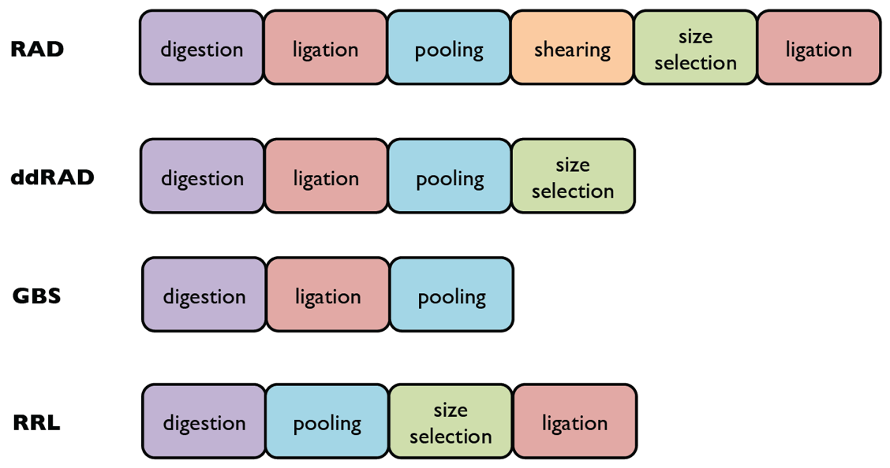
Sampling the genome
Used by the Roslin institute for their SNP arrays

Slide 5
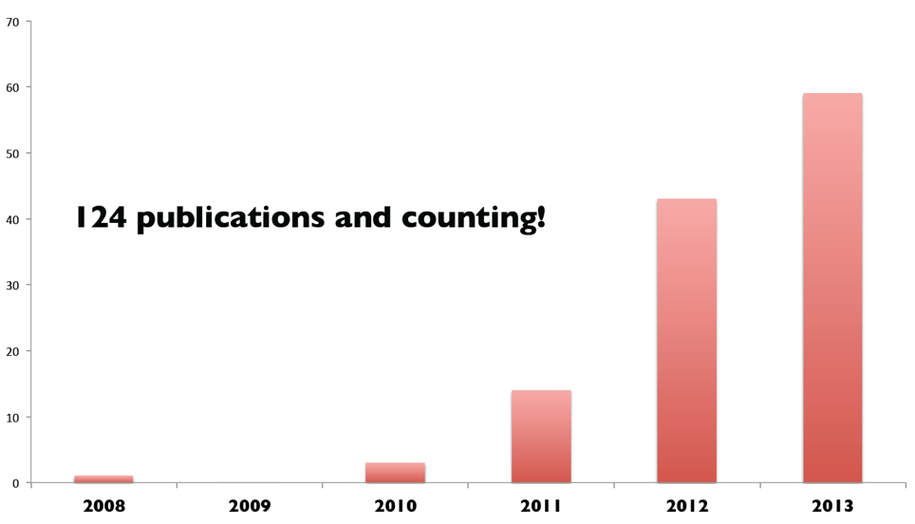
Sampling the genome
Original paper: Eric Johnsson, 2008
Hohenlohe is in the authorship of the first five

Slide 6
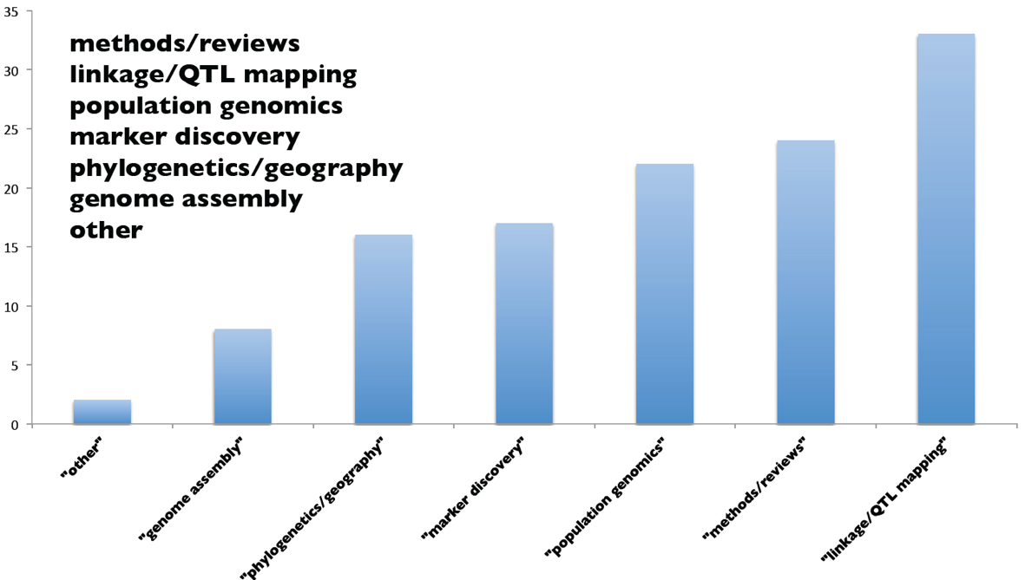
Applications

Slide 7
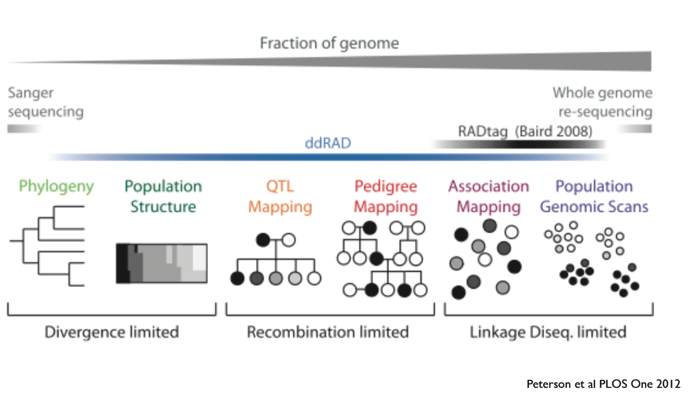
Applications

Slide 8
Protocols
Classic RAD

Slide 9
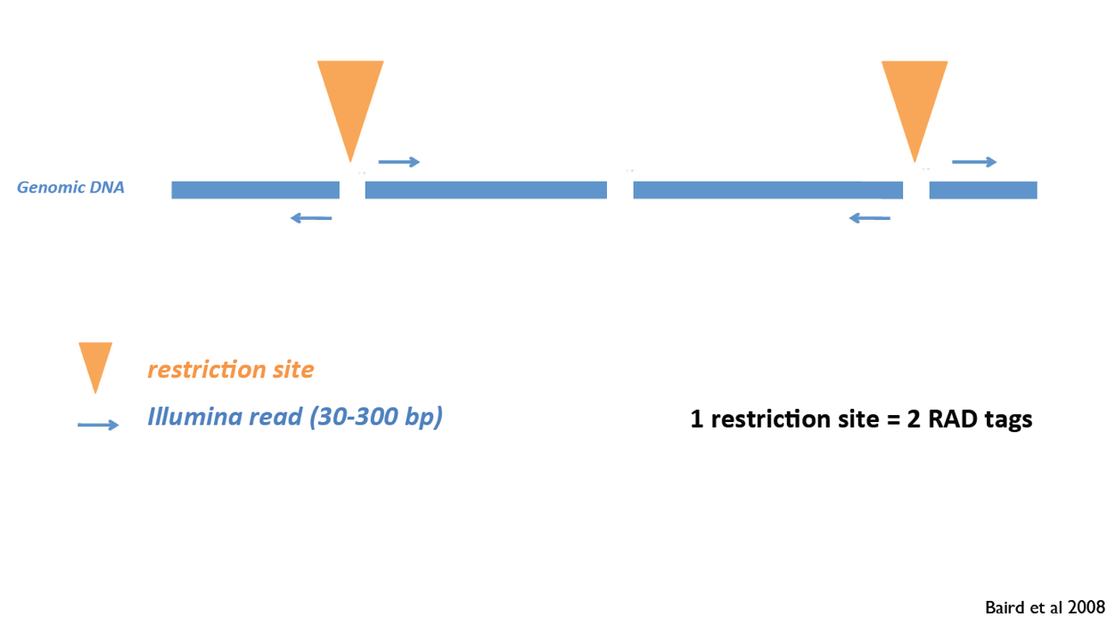
Single-end RAD

Slide 10
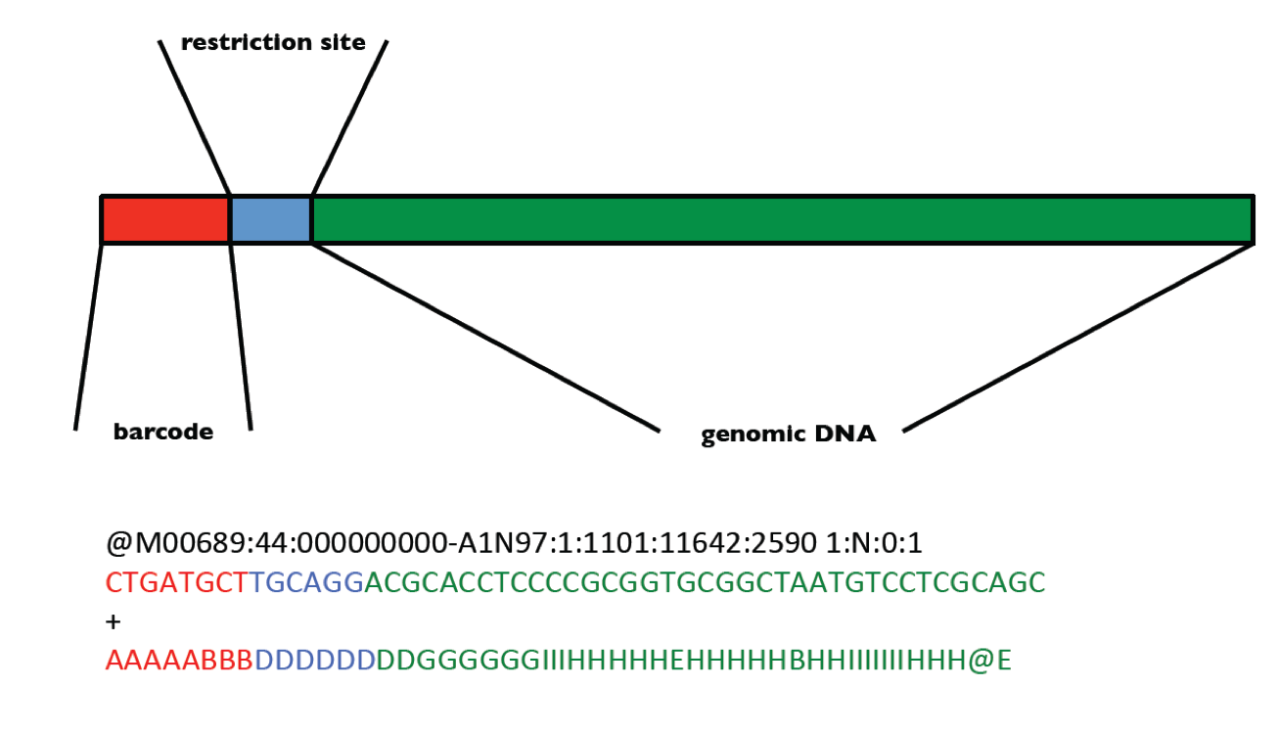
Single-end RAD

Slide 11
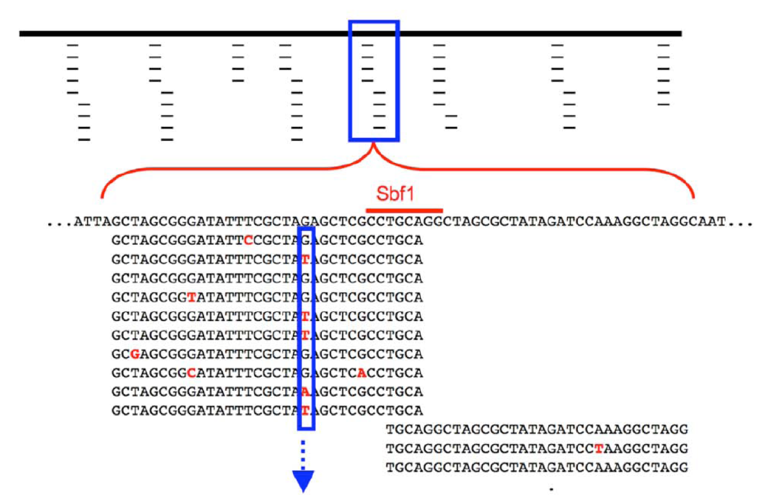
Single-end RAD
Cut 5’ -> 3’
Complementary strand
Hohenlohe et al., PLoS Genetics 2010

Slide 12
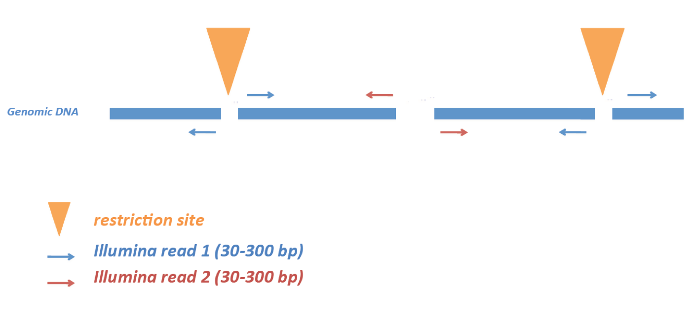
Paired-end RAD

Slide 13
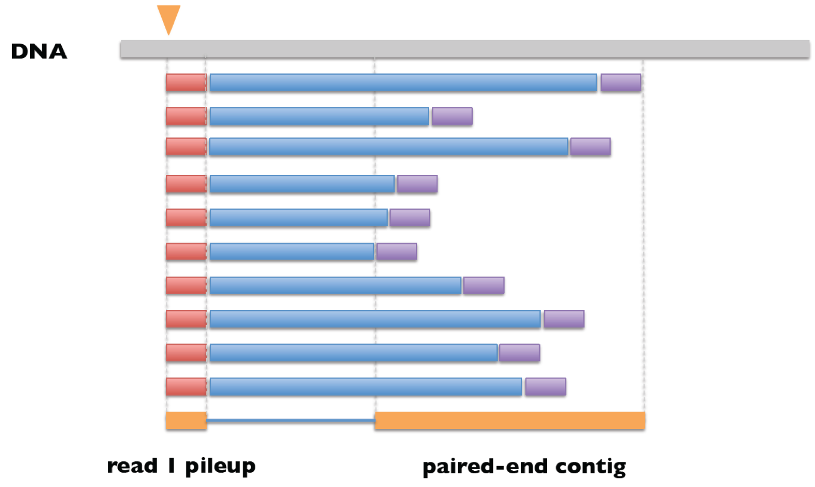
Paired-end RAD

Slide 14
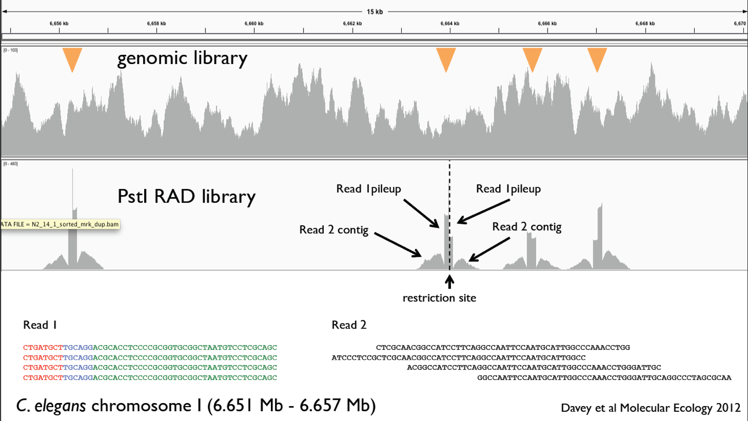
Paired-end RAD

Slide 15
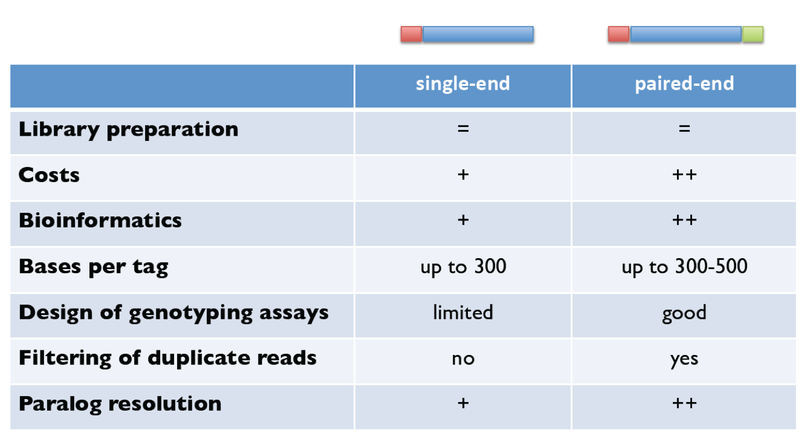
Single vs Paired-end RAD

Slide 16
Protocols
ddRAD

Slide 17
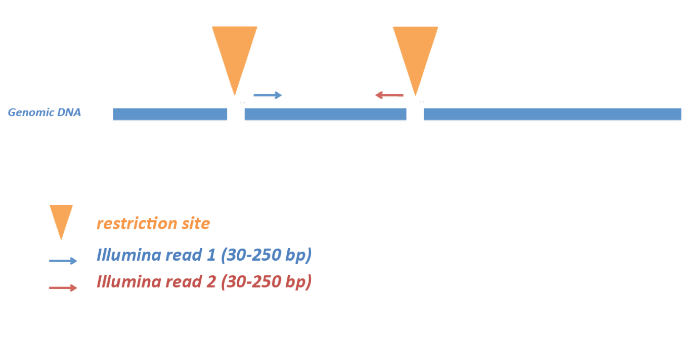
ddRAD

Slide 18
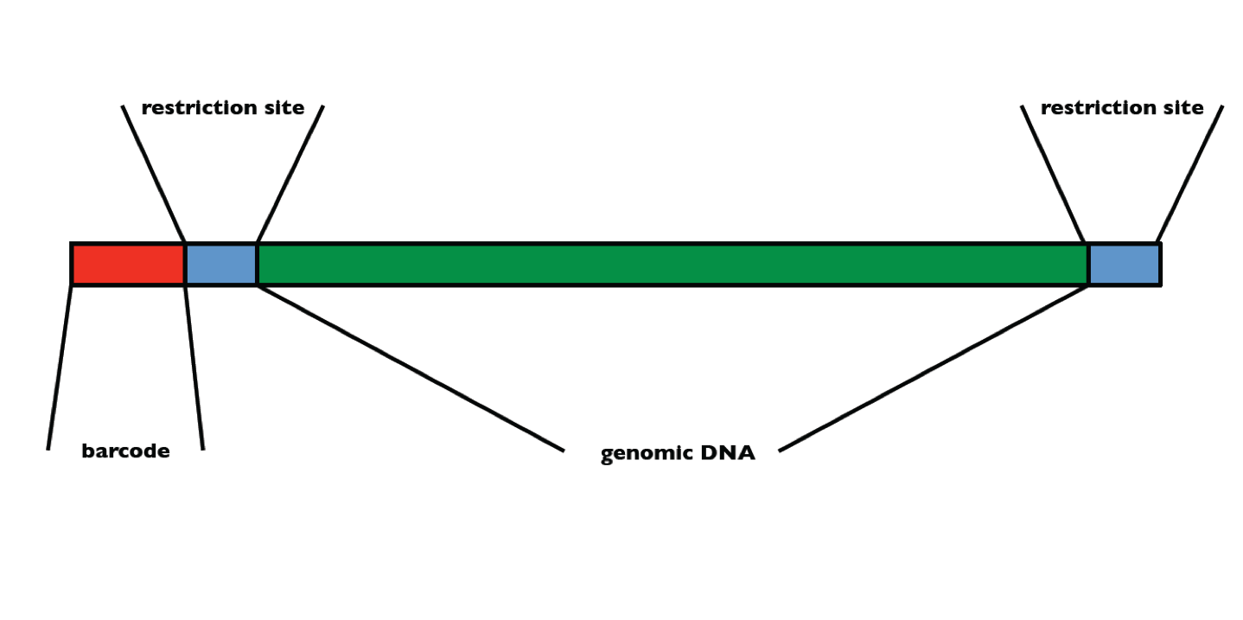
ddRAD
~ 500 pb

Slide 19
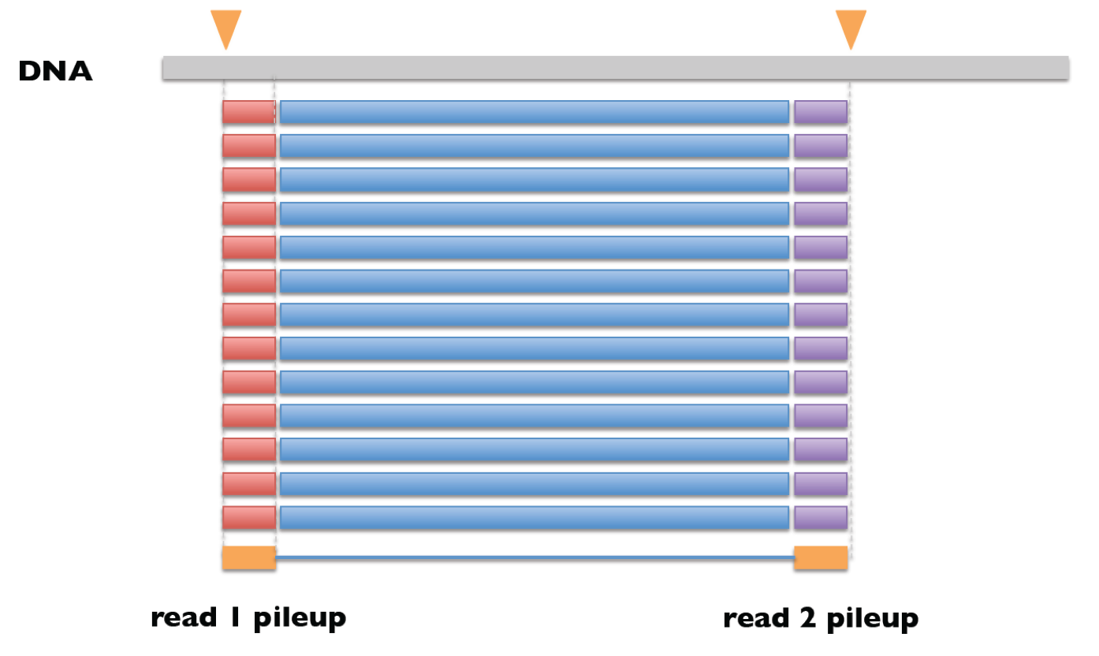
Paired-end ddRAD

Slide 20
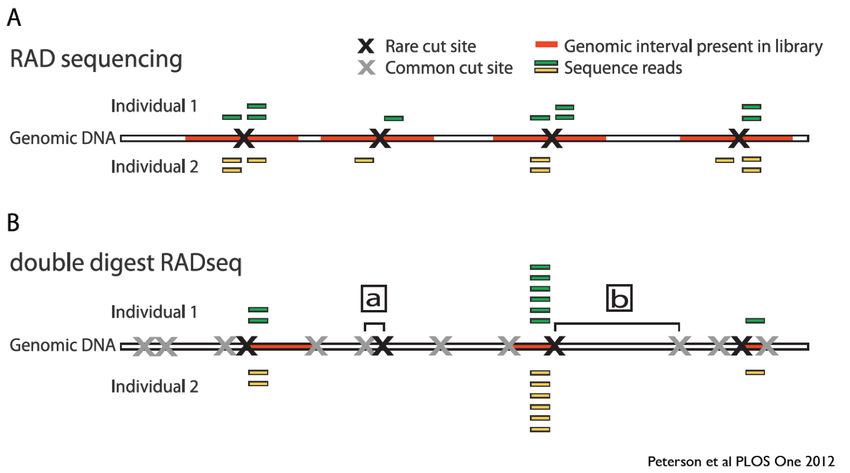
RAD vs ddRAD

Slide 21
RAD vs ddRAD
classic RAD: reads between the restriction site and a random site (shearing/sonication)
ddRAD: reads between the 2 restriction sites. So more flexibility on the balance coverage / depth of covarage

Slide 22
Common biases

Slide 23
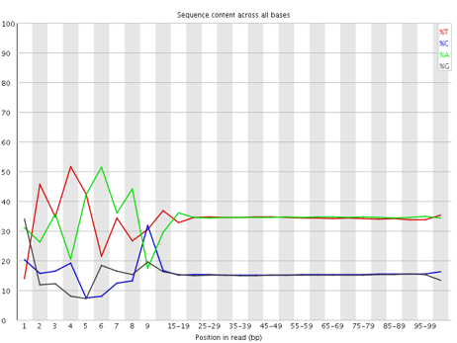
Biases
Because all reads begin with [half of] the restriction site
Consequence:
The Illumina sequencer have difficulty separating polonies/clusters during the first cycles imaging step
Solution:
use a set barcodes with different sizes
mix different experiences which use different restriction enzymes

Slide 24
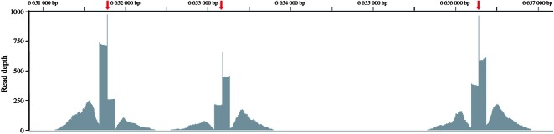
Biases
Restriction fragment length biases read depth
source: Special features of RAD Sequencing data: implications for genotyping (2013)

Slide 25
Biases
Mutations within the recognition sequence of the restriction enzyme
Consequence:
Allele dropout (ADO)
→ overestimates genetic variation both within and between populations
Solution:
Filter any loci that are not represented in all genotyped individuals
source: The effect of RAD allele dropout on the estimation of genetic variation within and between populations (2012)

Slide 26

Advice/Information from the
250 ng of DNA is needed, 1 µg is asked by the Edinburgh genomics
High quality DNA if not from 30 to 40% of data can be useless
PCR: 12 to 14 cycles to reduce the PCR duplicates
Warning: QiaGen Licence / Patent

Slide 27
THE RAD FAMILLY
PROS / CONS

Slide 28
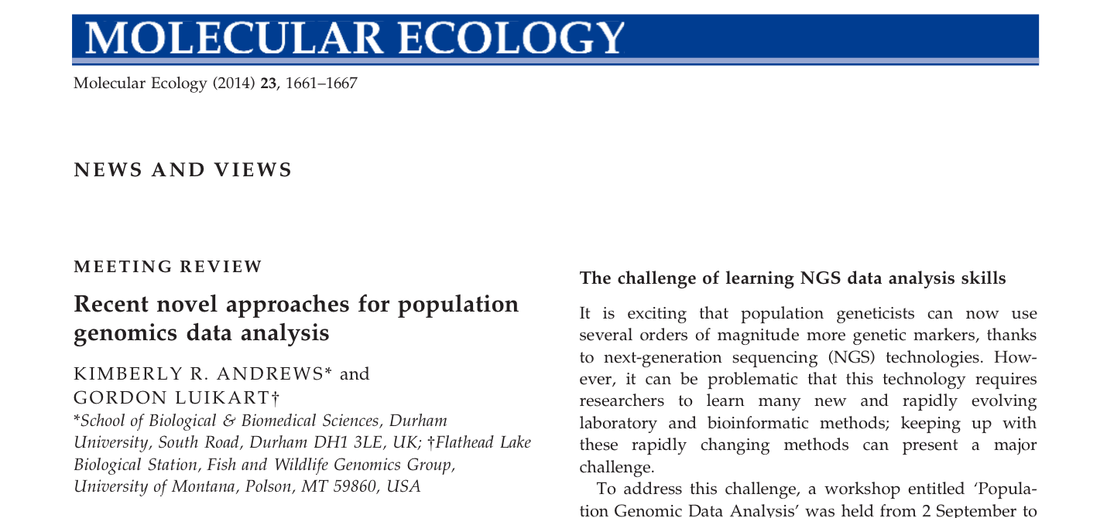
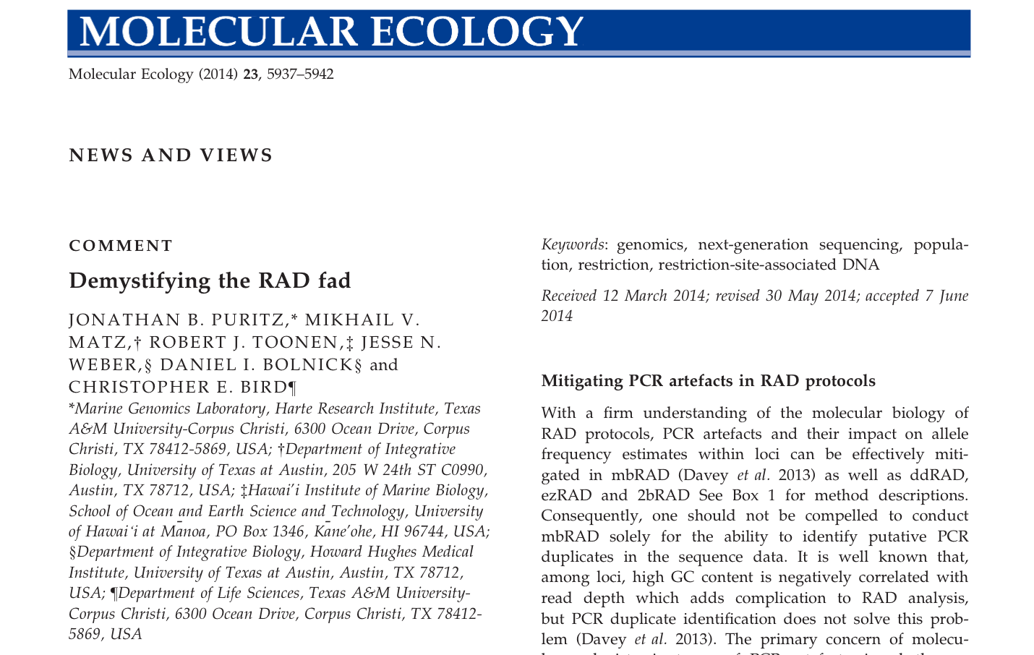

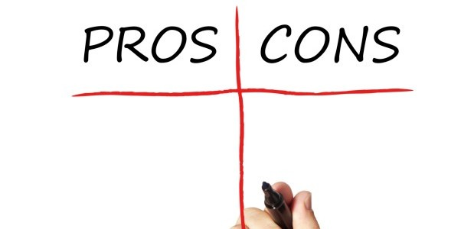
BATTLE

Slide 29
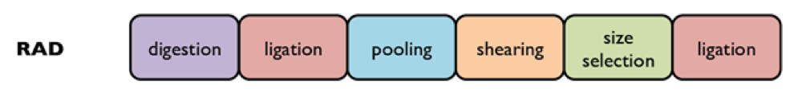
mbRAD
Original RAD (mbRAD Miller et al. 2007 and Baird et al. 2008)
Genomic DNA digestion by 1 restriction enzyme (low frequency cutter)
Ligation of barcode containing adapters onto digested 5’ ends
Ligated genomic DNA sonication
Ligation of a 3’ adapter to the sonicated end
Pooling of the samples
Size-selection of the library
RAD fragments PCR enrichment

Slide 30
mbRAD - PROS
Random shearing of the 3’ end helps to identify putative PCR duplicates
If identical starting position of the paired-end read: duplicate
Random shearing improves the distribution of coverage
Random shearing + larger insert size ranges: de novo assembled RAD loci are of greater length
Critical for identifying function & Gene ontology
Coverage and quality are fundamental!!!
Distinguishing true SNP from sequencing error: if coverage is low, your statistical test will not yield significant results!

Slide 31
mbRAD - CONS
The most technically challenging and complex protocol!
Requires non standard lab equipment: sonicator
Restriction fragment length bias (due to the shearing)
Sequencing at different depth
Strand bias
Different genotypes from forward & reverse reads
Solution: Filter any loci in this case… only possible in 2bRAD

Slide 32
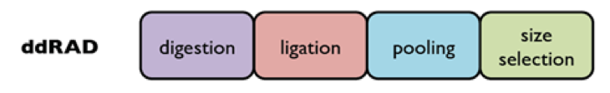
ddRAD
Double digest RAD protocol (Peterson et al. 2012)
Genomic DNA digestion by 2 restriction enzymes (low + high frequency cutter)
Ligation of barcode P1 adapters (matching the first restriction site) and P2 adapters (matching second restriction site)
Pooling of the samples
Size-selection of the library
RAD fragments PCR enrichment + second barcode introduction to increase multiplexing potential
Extremely similar to GBS (Poland et al. 2013)
Pros & cons associated with ddRAD also relevant to RESTseq (Stolle & Moritz 2013)

Slide 33
ddRAD - PROS
Greatest degree of customization
Depending on the chosen enzymes & the selected range of fragment sizes
Allow to have hundreds of SNPs per individual at very low cost or thousands for QTL mapping experiments at moderate cost
Flexibility on the balance coverage / depth of covarage
Examine histograms of digested samples early
Identify / exclude excessively frequent fragments (i.e. transposons)

Slide 34
ddRAD - CONS
Using fragment size selection to tune the quantity of loci can lead to variable representation of some loci
This can be minimized using precise selection tool (i.e. Pippin Prep)
Particularly susceptible to ADO (Arnold et al. 2013)
To be considered when performing sensitive population genetic analyses
Requires the highest quality genomic DNA of all RAD methods
Proper fragment ligation relies on completely intact 5’ & 3’ overhangs!
PCR duplicates cannot be detected

Slide 35
ezRAD
ezRAD protocol (Toonen et al. 2013)
Genomic DNA digestion by 2 restriction enzymes (high frequency cutter on the same cut site)
Commercially available Illumina TruSeq library preparation kit
DNA end reparation
Ligation of single or dual indexing adapters onto genomic fragments
Pooling of samples
Size selection of the library
RAD fragments PCR enrichment, or not, depending on the Illumina kit

Slide 36
ezRAD - PROS
Illumina TruSeq kit
Extensive manual, customer support & guarantee
Probably the simplest path to obtain RAD data for small lab without experience / equipment / resources to develop in-house RAD capability
Combined with an Illumina PCR-Free TruSeq kit, ezRAD is the only RAD protocol that can bypass all potential PCR bias

Slide 37
ezRAD - CONS
Illumina TruSeq kit
Simplicity & uniformity but expensive
However can be used with ½ & 1/3 reaction volumes
All ezRAD reads start with the same four GATC bases
The first 4-5 nucleotides of Read 1 are used to discriminate between adjacent clusters
If always the same 4 first bases, difficulty to discriminate the different samples

Slide 38
2bRAD
2bRAD protocol (Wang et al. 2012)
Genomic DNA digestion by 1 restriction enzyme (36-bp fragments excision recognition site + adjacent 5’ & 3’ base pairs)
Ligation of dual barcode adapters
Agarose gel target band excision after PCR enrichment
No intermediate purification stages
No size-selection

Slide 39
2bRAD - PROS
Extreme protocol simplicity & cost-efficiency
No intermediate purification stages
No need for special instrumentation (only PCR + standard agarose gel)
Lack of biases due to fragment size selection
All endonuclease recognition sites can be sampled

Slide 40
2bRAD - CONS
Difficulties to map 36 bp tags in a unambiguously way
But works well in no or moderately duplicated genomes (i.e. Wang et al 2012 on Arabidopsis)
2bRAD fragments cannot be used to build genome contigs
2bRAD fragments are less likely to be cross-mappable across large genetic distances, such as across different species

Slide 41
Conclusions
Most important considerations when selecting a particular RAD protocol are
The facilities & the molecular experience of the researcher applying the approach
The biology of the organisms
The hypotheses being tested
All RAD protocols are powerful tools for SNP discovery & genotyping of nonmodel species
It is important to learn about pitfalls inherent to each method & how to adress them

Slide 42
SOFTWARES

Slide 43
Main Bioinformatics pipelines
STACKS
Website: http://catchenlab.life.illinois.edu/stacks/
mbRAD, ddRAD, ezRAD & 2bRAD?
STACKS does not handle INDELS, so any loci near an INDEL is lost
STACKS does not call SNPs from paired end reads natively, and does especially poorly with paired end fragments that are not of a random length (e.g., ddRAD and ezRAD)
dDocent
Website: https://ddocent.wordpress.com/ddocent-pipeline-user-guide/
ddRAD & ezRAD
PyRAD
Website: http://dereneaton.com/software/pyrad/
mbRAD, ddRAD, PE-ddRAD, GBS, PE-GBS, EzRAD, PE-EzRAD, 2B-RAD
use of an alignment-clustering method (vsearch)
2bRAD (Wang et al 2012)
de novo: https://github.com/z0on/2bRAD_denovo
With reference genome: https://github.com/z0on/2bRAD_GATK
2bRAD

Slide 44

SOFTWARES

Slide 45
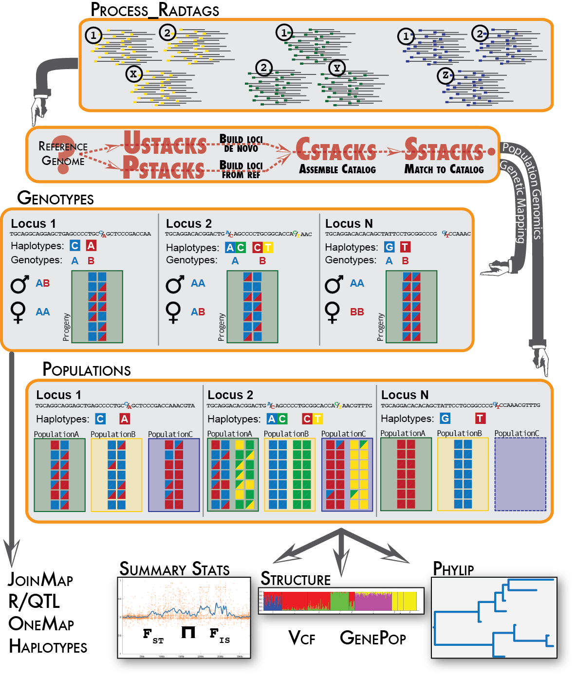
Stacks
http://catchenlab.life.illinois.edu/stacks
J. Catchen, A. Amores, P. Hohenlohe, W. Cresko, and J. Postlethwait.
Stacks: building and genotyping loci de novo from short-read sequences.
G3: Genes, Genomes, Genetics, 1:171-182, 2011.

Slide 46
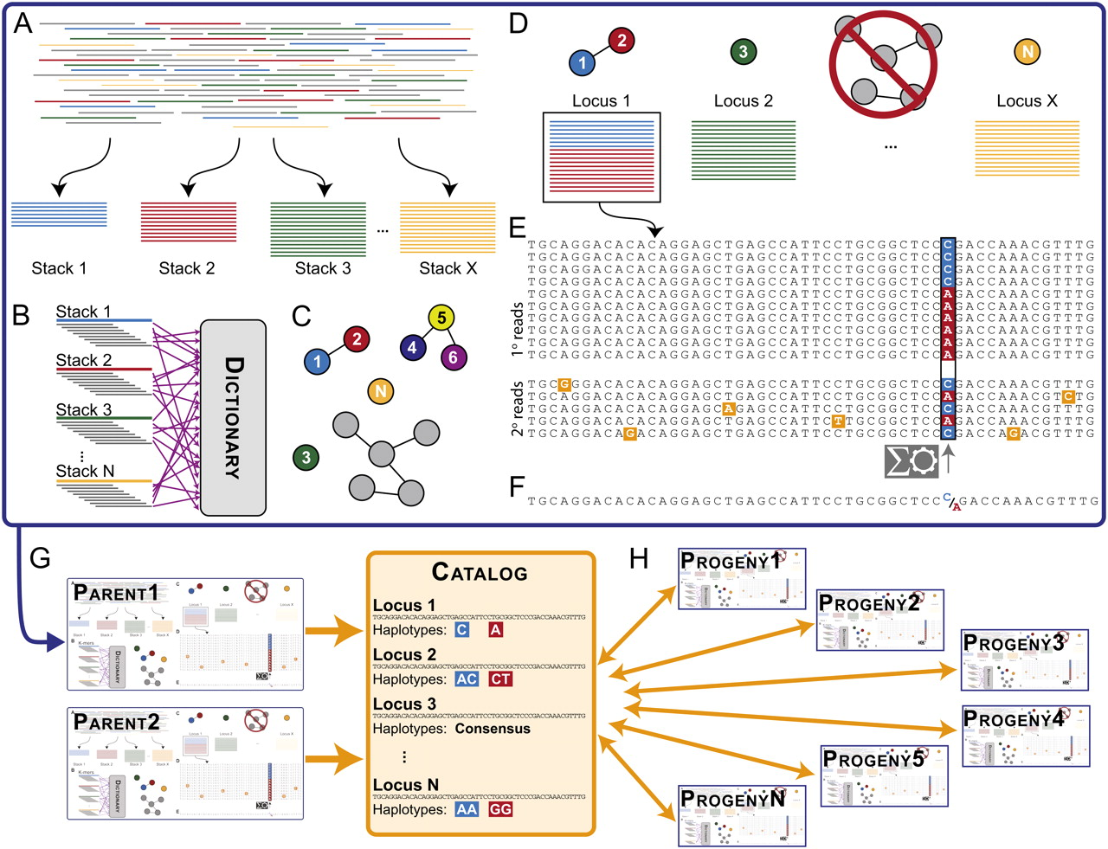
Stacks
denovo_map pipeline
ustacks
cstacks
sstacks

Slide 47
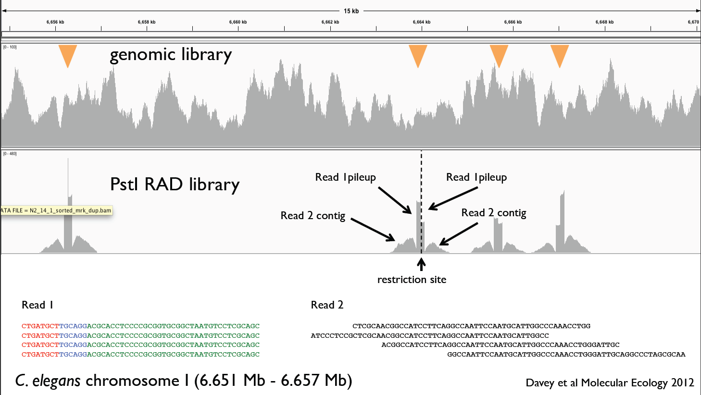
Stacks
ref_map pipeline
pstacks
cstacks
sstacks
.bam
.bam
.bam

Slide 48

SOFTWARES
+

Slide 49
Today: hands on
SNP detection
On 2 parents of a family
Genetic map
On a family with 93 offsprings
Mini-contig assembly
Paired end data
Population genomics
Without reference genome
With reference genome

Slide 50
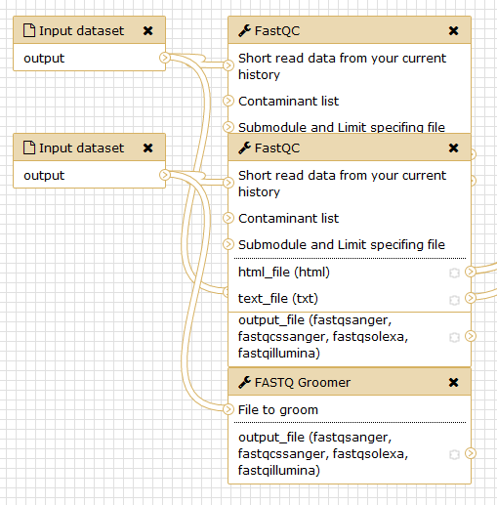
Today: hands on
SNP detection
On 2 parents of a family
Genetic map
On a family with 93 offsprings
Mini-contig assembly
Paired end data
Population genomics
Without reference genome
With reference genome

Slide 51
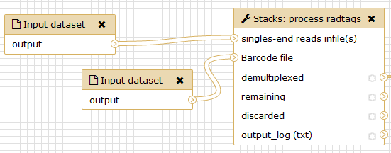
Today: hands on
SNP detection
On 2 parents of a family
Genetic map
On a family with 93 offsprings
Mini-contig assembly
Paired end data
Population genomics
Without reference genome
With reference genome

Slide 52
Goals
Learning to analyse NGS data from Reduce-Representation Libraries (RRL)
Learning to use
Galaxy
The STACKS pipeline
Learning
Raw Illumina RAD preparation
Use a reference genome
Assembly of RAD loci
Detection of SNPs, genotypes and haplotypes determination
Population genetics statistics

Slide 53
Datasets and tools
Datasets used during Julian Catchen training sessions
Stickleback dataset from Hohenlohe et al. 2010
Data cleaning and analyses with Galaxy, the Stacks pipeline and BWA.
All data produced with Illumina GAII or HiSeq2000.
Open Source software

Slide 54
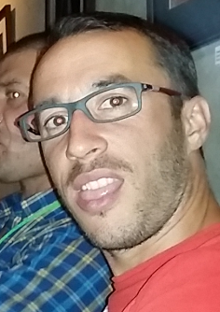
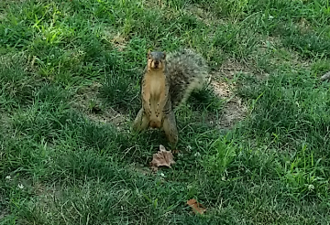
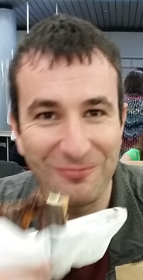
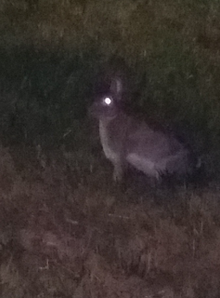
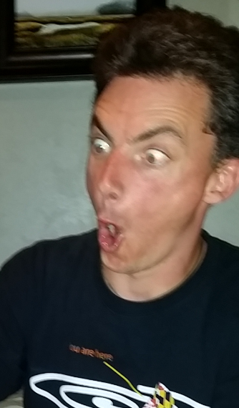
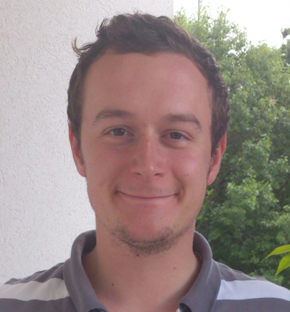
Merci de votre attention
RADseqGCC2016 page http://tinyurl.com/radseqgcc2016
AWS Galaxy server http://54.197.189.163/
GenOuest Galaxy instance galaxy.genouest.org
Notes:
-Les limites d'1 communauté ne sont pas arrêtées en fonction de notions de tailles mais bien d'objectifs communs à atteindre et donc de processus et ....
-
Ainsi, des communautés peuvent se former à différents niveaux d'abstraction, que ce soit pour l'hypoxie du flet par exemple ou plus meta comme l'utilisation de la génomique en écologie, mais aussi avec un nombre d'action et / ou type de taches différent à accomplir, uniquement aboutir a la creation de 3 outils d'analyse et d'1 workflow utilisable par la communauté, ou faire de la veille sur un sujet particuliers.....
Cette communauté peut utiliser des outils d analyse via les portails proposés et / ou proposer d'enrichir le "catalogue" d outils proposé et / ou de proposer des evolutions des logiciels et autres....
Il y a ainsi un va et vient entre communauté et outils, rien n'est fixe et vous pouvez faire evoluer les choses.
On propose aujourd hui, ds le cadre de ce projet preparatoire, de tester les outils deja mis en place, en profitant de l environnement proposé par la pf genouest, de tester l'application de ces concepts e-science sur un nombre restreint de communauté ciblés, afin de posséder des infos essentielles pour un futur passage a l'echelle dans le cadre par exemple de la mise en place d un centre eScience. Pour cela, on veut des gens de Brest! L ideal serait d'avoir une communauté a un assez haut niveau meta, un peu transversale au niveau thematique et egalement regroupant des equipes de recherches distribuees sur le territoire (brest et rennes, ecologie et genomique?) et aussi une communauté bien plus ciblée et restreinte (archés extremophile).

